Slide 1



Dead-Locks in
Operating Systems
225+147

Slide 2
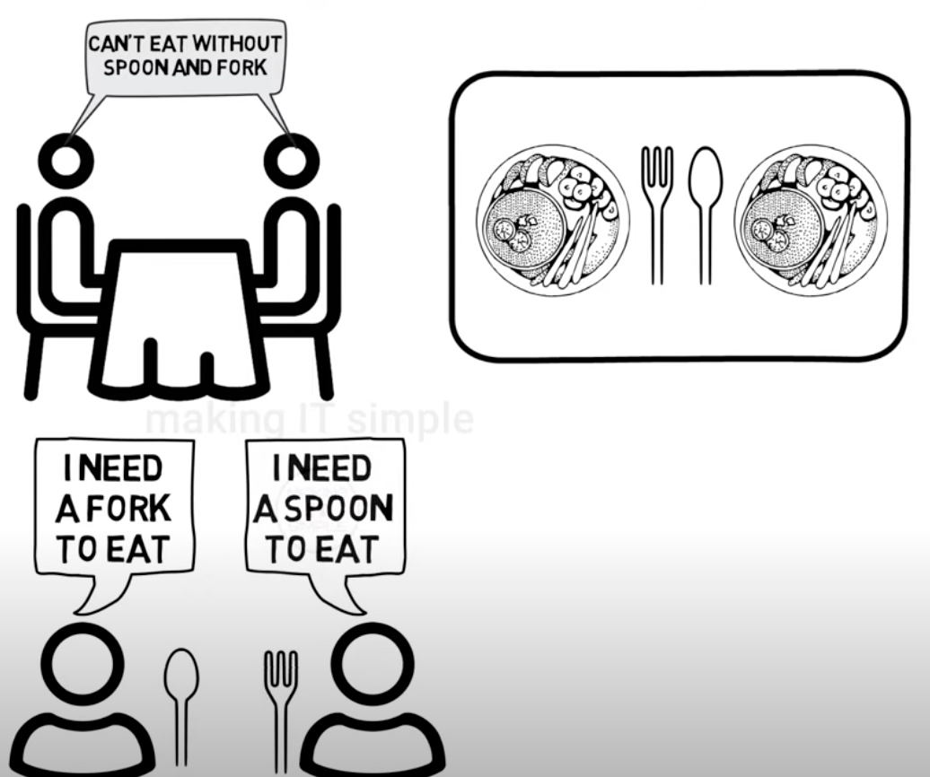

Deadlock

Slide 3


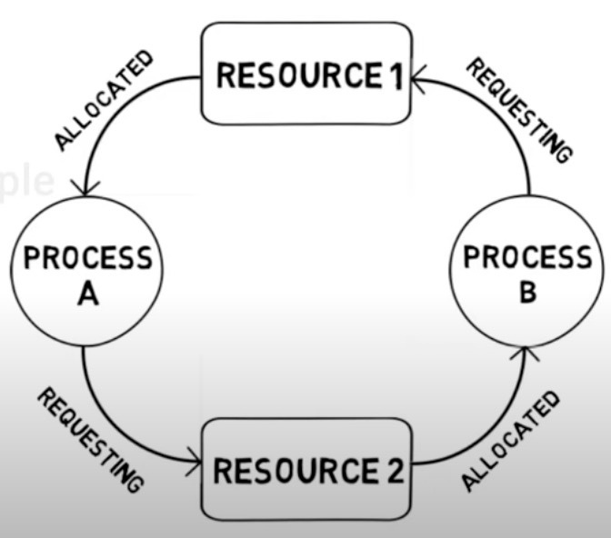

What is a Dead-Lock ?
It is situation when two processes sharing the same resources are effectively preventing each other from accessing the resources

Slide 4
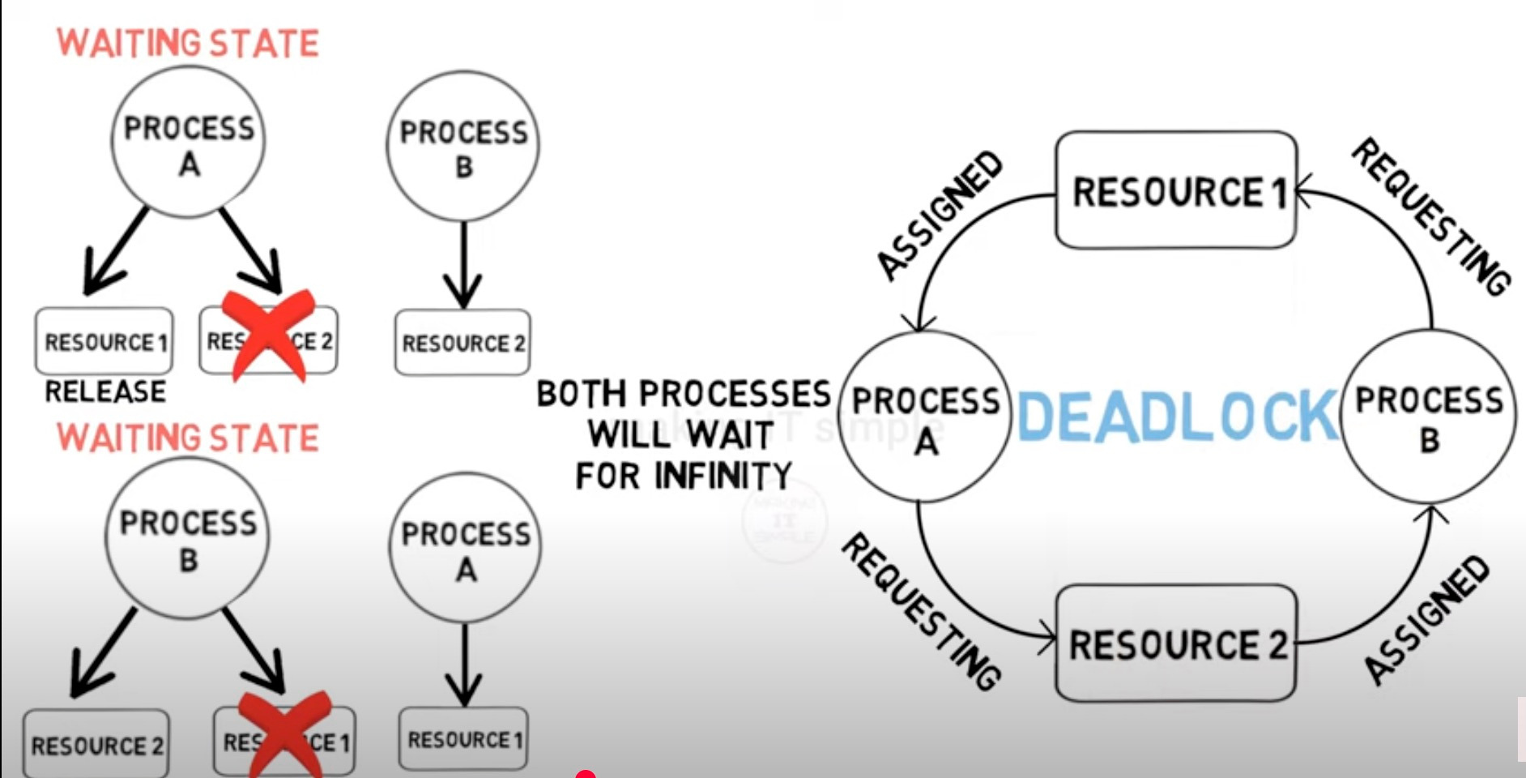

Slide 5

Introduction:
System Model
Deadlock characterisation
Method for handling deadlocks
Deadlock Prevention
Deadlock Avoidance
Deadlock Detection
Recovery from Deadlock

Slide 6

System Model :
A system has a finite set of resources (e.g., CPU, printers, memory).
Resources are categorized into types (e.g., R1, R2, ..., Rn), each with multiple instances.
Processes interact with resources in three steps:
Request: Ask for a resource.
Use: Utilize the resource.
Release: Free the resource for others.
This model can lead to deadlock if processes block each other while waiting for resources

Slide 7


2.Deadlock Characterisation :
Mutual exclusion
Hold & Wait
No Preemption
Circular wait

Slide 8
Recource Allocation Graph:
A set of vertices V and a set of edges E :
V
E
Request edge
P R
Assignment edge
P R
P
R
Process
Resource

Slide 9
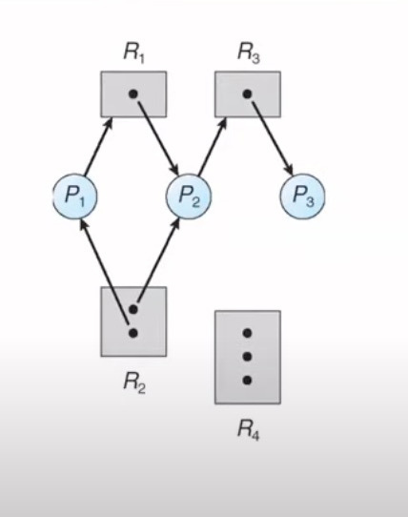
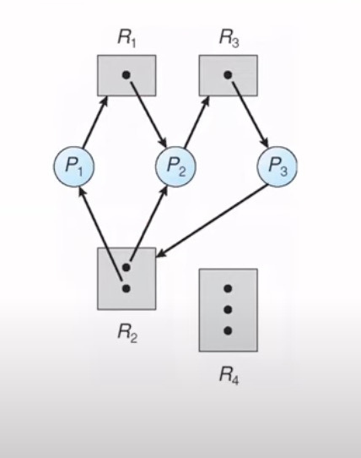
Resource allocation graph
Resource allocation graph with deadlock

Slide 10
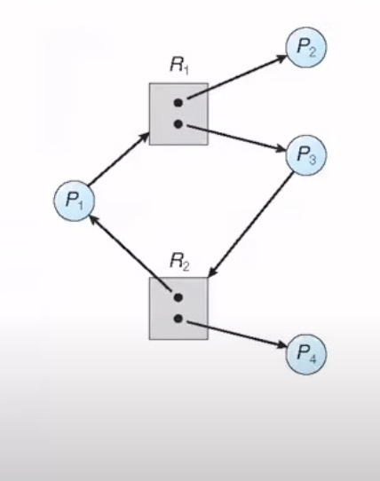

Graph with a cycle but no deadlock
Graph with a cycle but with deadlock

Slide 11

Attention:
If a graph no cycle No Deadlock
If a graph contains a cycle :
If only one instance per resource type then deadlock
If several instances per resource type possibility of deadlock

Slide 12
Mutual exclusion
Definition:
Only one process can use a resource at a time, preventing multiple processes from accessing it simultaneously. This is essential for resource integrity but can contribute to deadlock if resources are held indefinitely
Example:
a printer can only be used by one process; if another process needs it while the first holds it, a deadlock may occur.

Slide 13
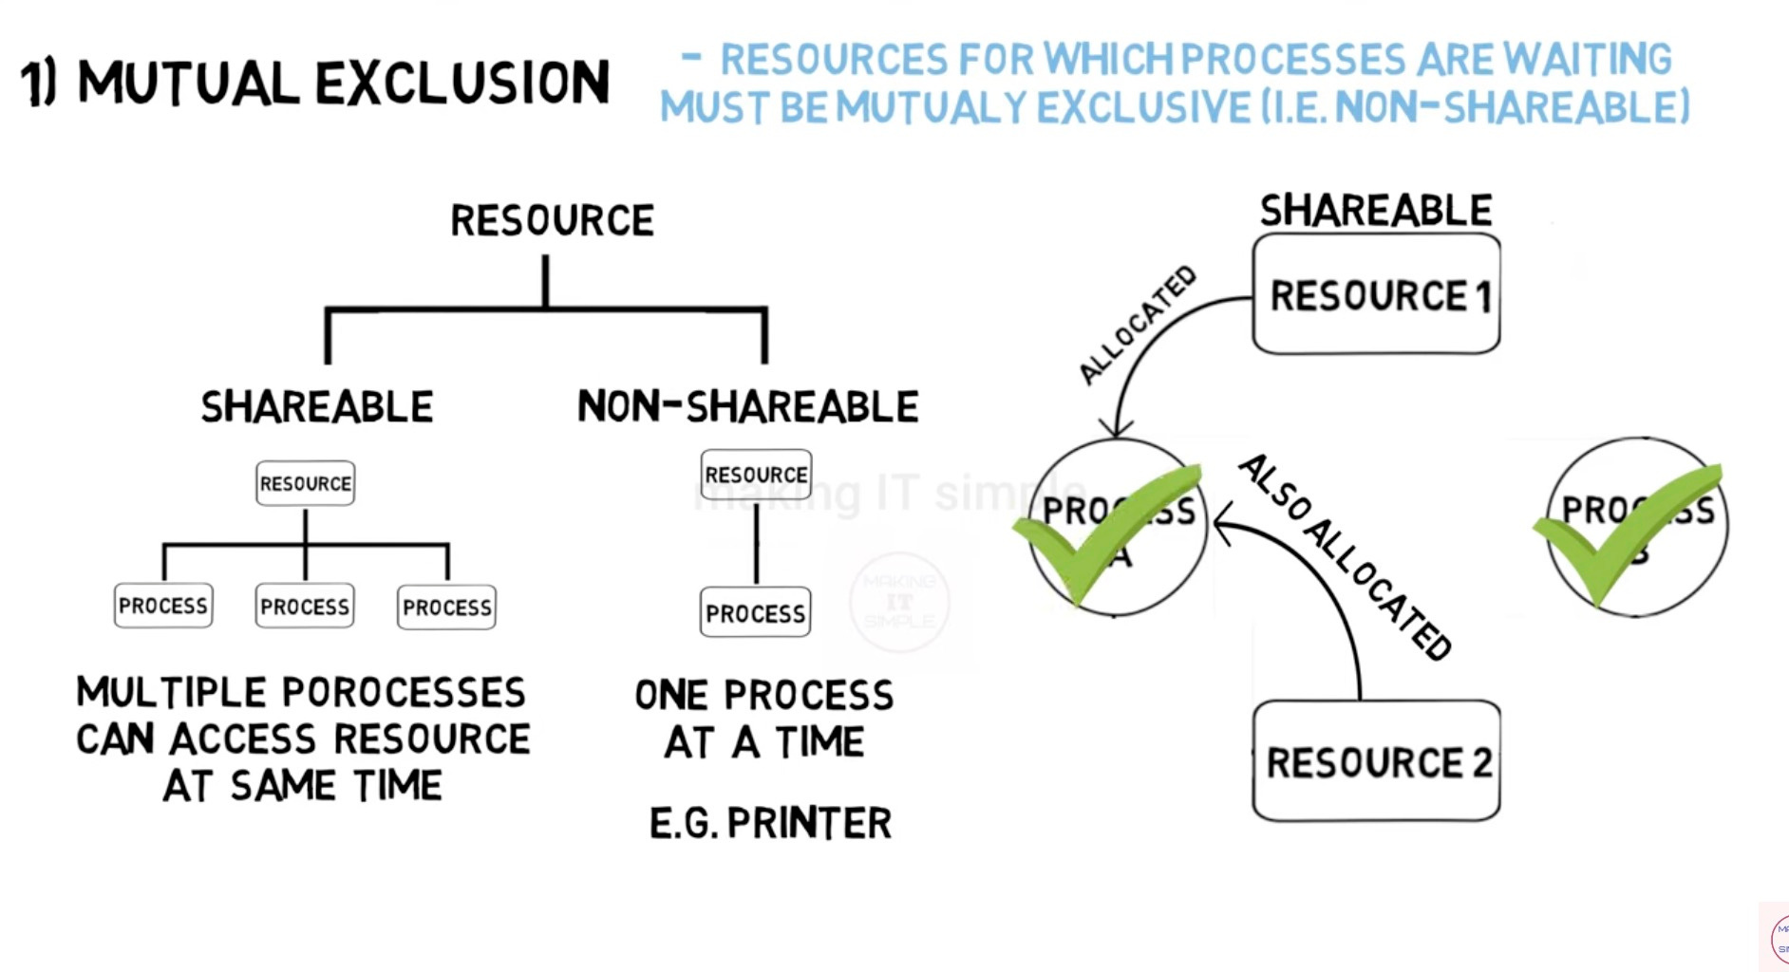

Slide 14
Hold & Wait
Definition:
A process holds at least one resource while waiting to acquire additional resources, potentially leading to a deadlock if other processes hold the needed resources.
Example:
Process A holds a CPU and waits for a printer, while Process B holds the printer and waits for the CPU.

Slide 15
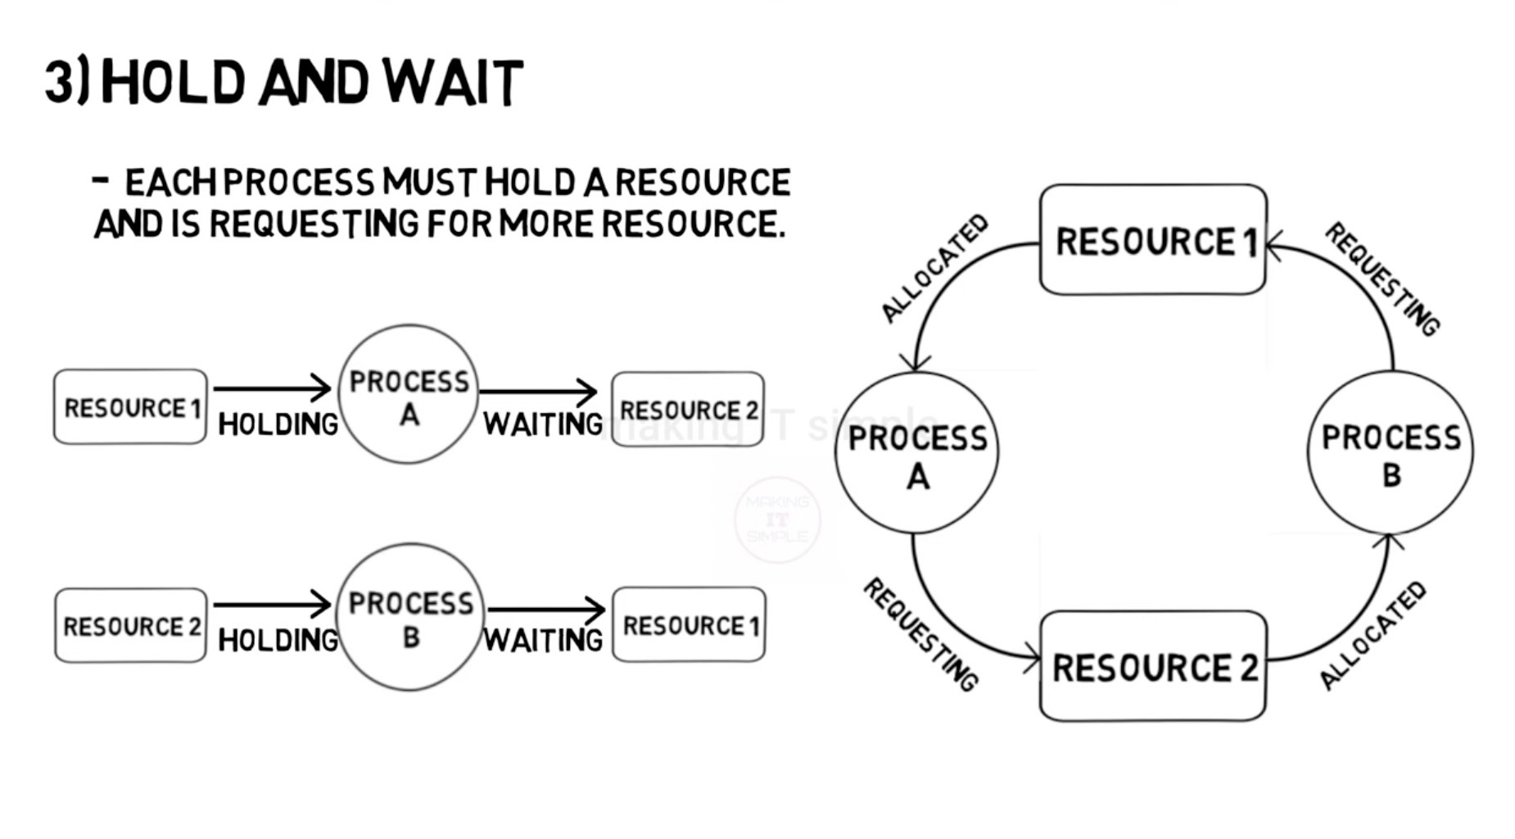

Slide 16


No Preemption
Definition:
Resources cannot be forcibly taken from a process; they must be released voluntarily by the process itself, which can lead to deadlock if a process never releases a resource.
Implication:
If a process holding a critical resource crashes or stalls, other processes waiting for it remain blocked.

Slide 17
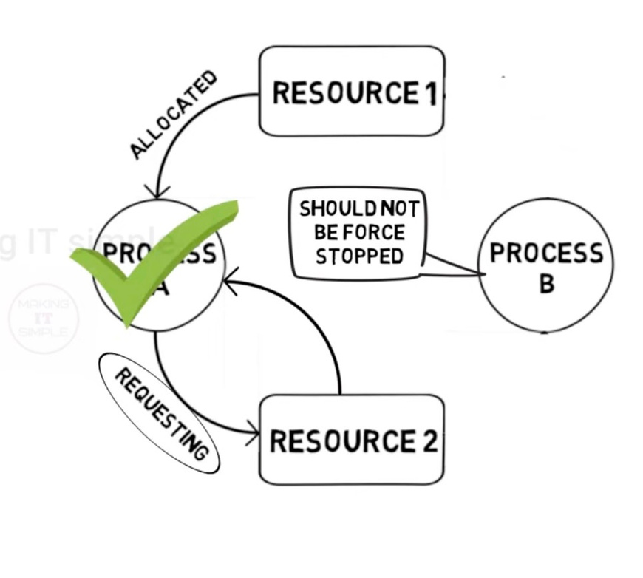
No Preemption

Slide 18

Circular wait
Definition:
A set of processes form a circular chain where each process waits for a resource held by the next, creating a deadlock cycle.
Example:
P0 waits for P1’s resource, P1 waits for P2’s, and P2 waits for P0’s resource."

Slide 19
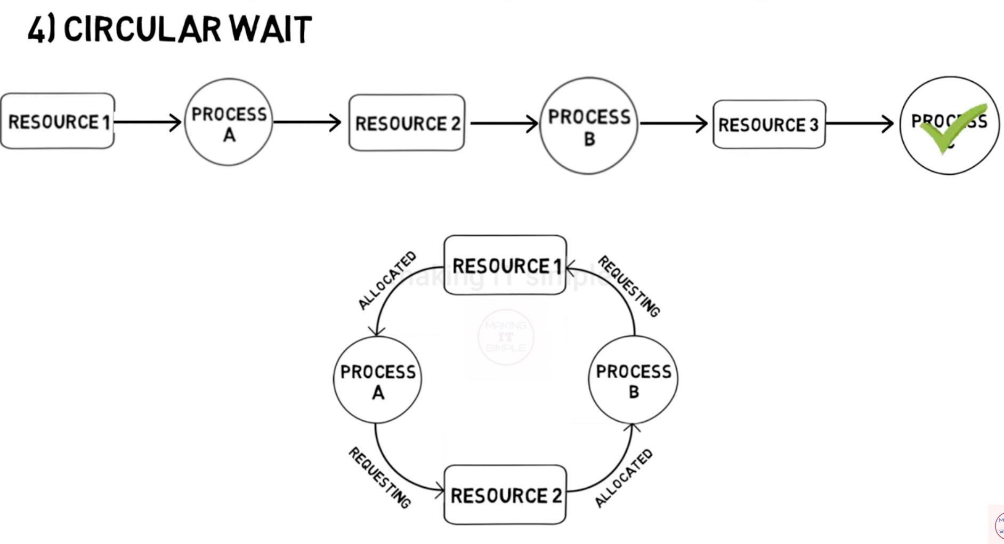

Slide 20
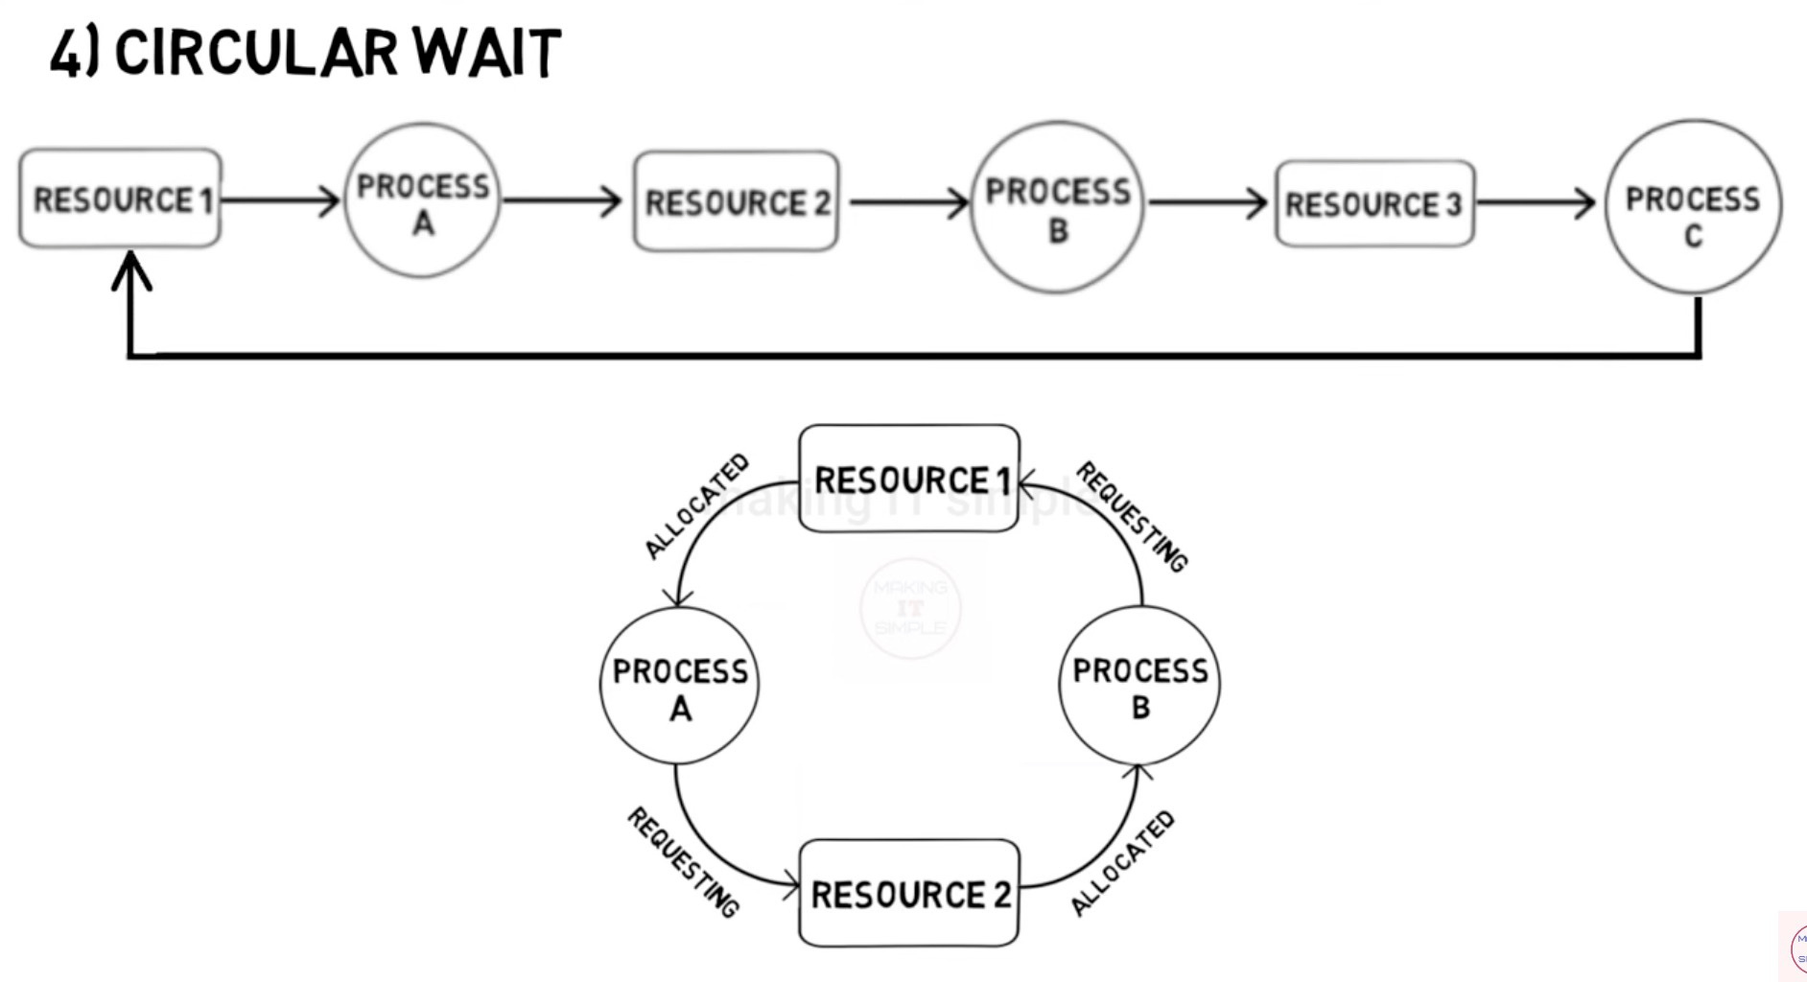

Slide 21



Slide 22
How to handle Deadlock ?
Deadlock ignorance
Deadlock Prevention
Deadlock Avoidance
Deadlock Detection
&
Recovery

Slide 23
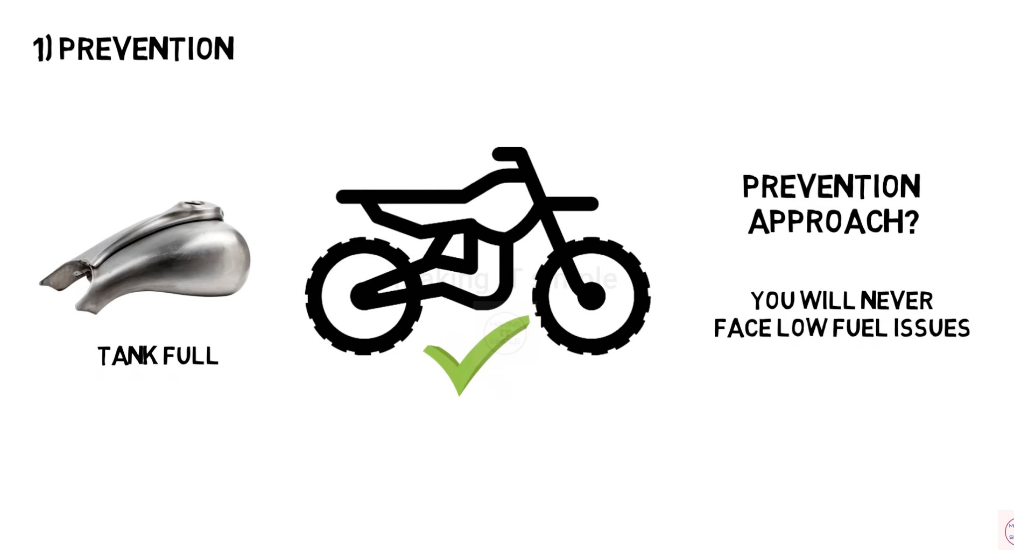

Slide 24
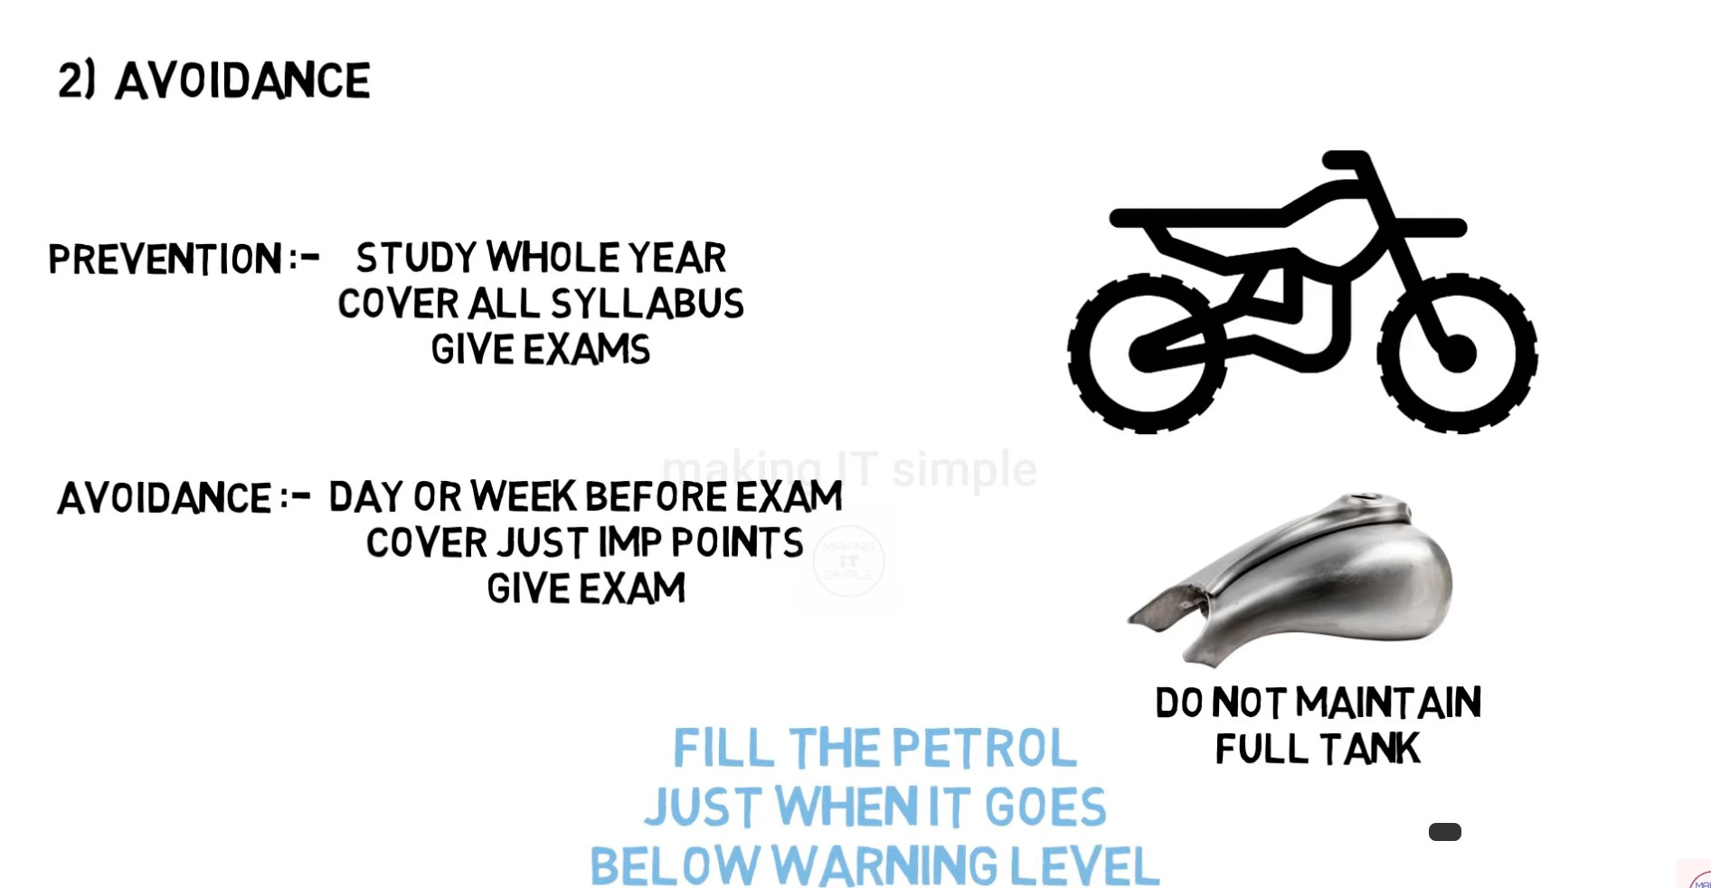

Slide 25
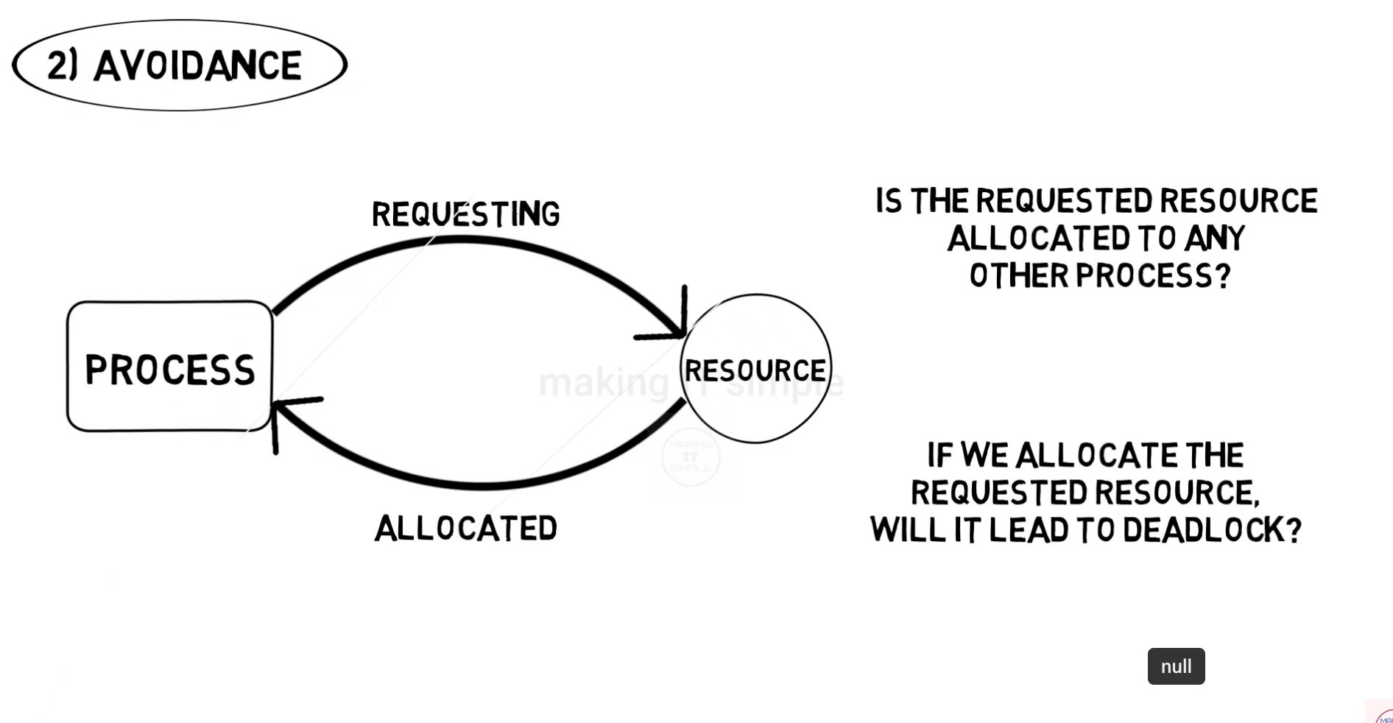

Slide 26
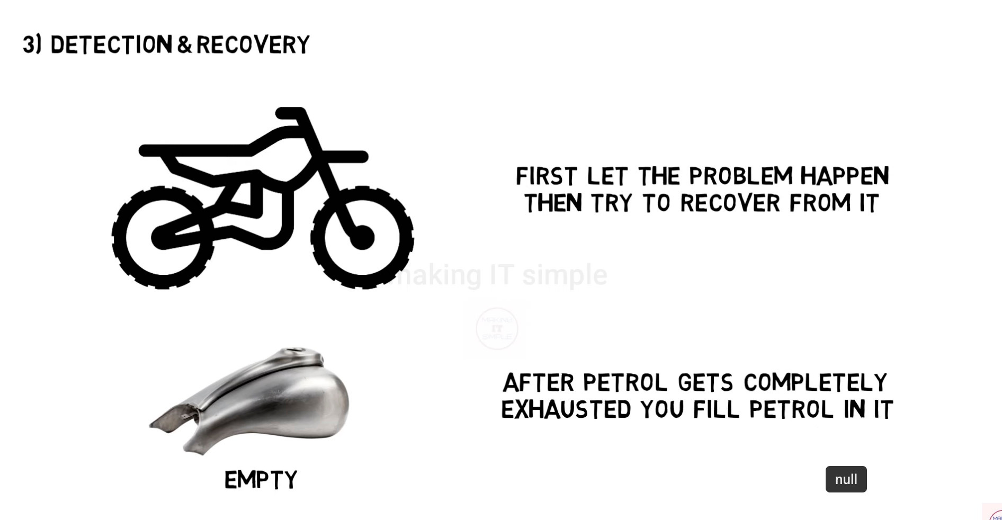

Slide 27
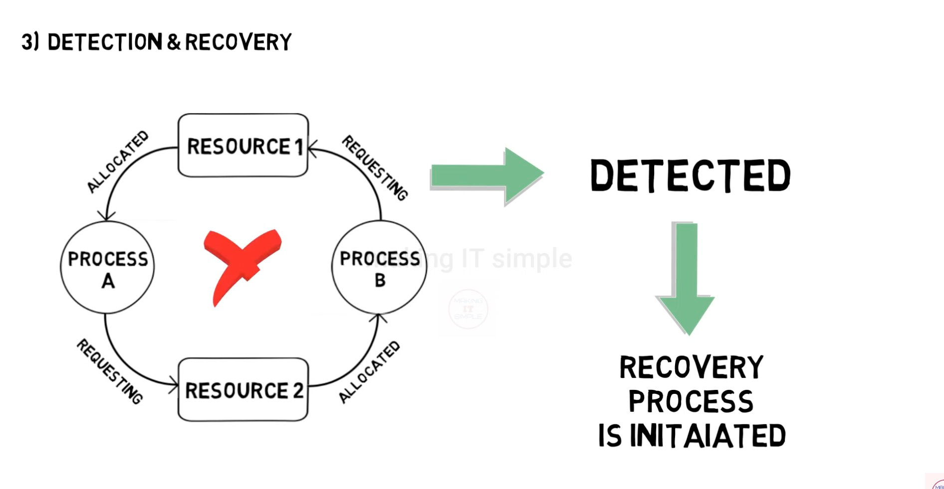

Slide 28


Slide 29
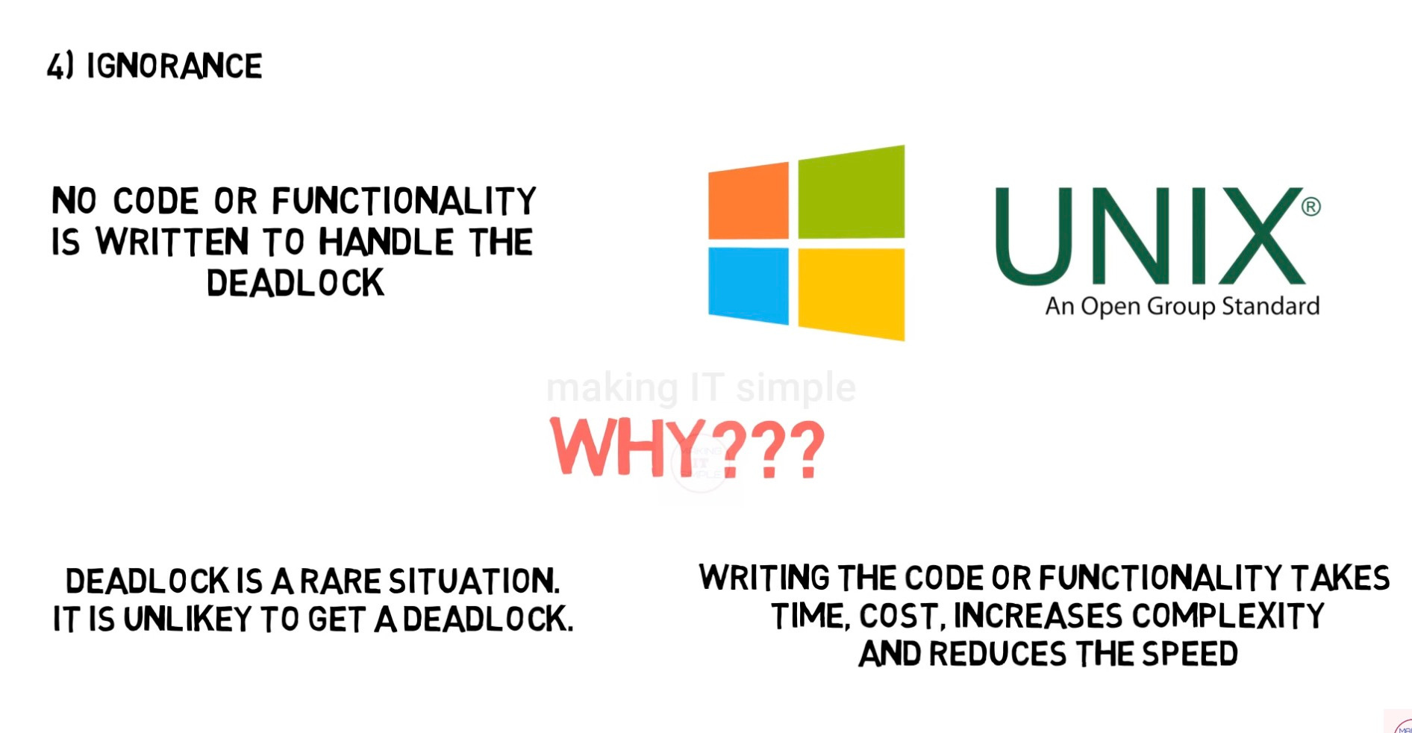

Slide 30


Deadlock Ignorance:
Ignore and restart your system
If you write a code od deadlock your system perfermances will decrease the speed also
Advantages of ignoring deadlock code
Your system perfemance will increase and increase the speed also

Slide 31



Deadlock Prevention Techinques:
Mutual exclusion
No preemption
Hold & Wait
Circular wait
Deadlock

Slide 32


Deadlock prevention
Mutual exclusion
Just share the resources
In same case is imposible
example : Printer

Slide 33
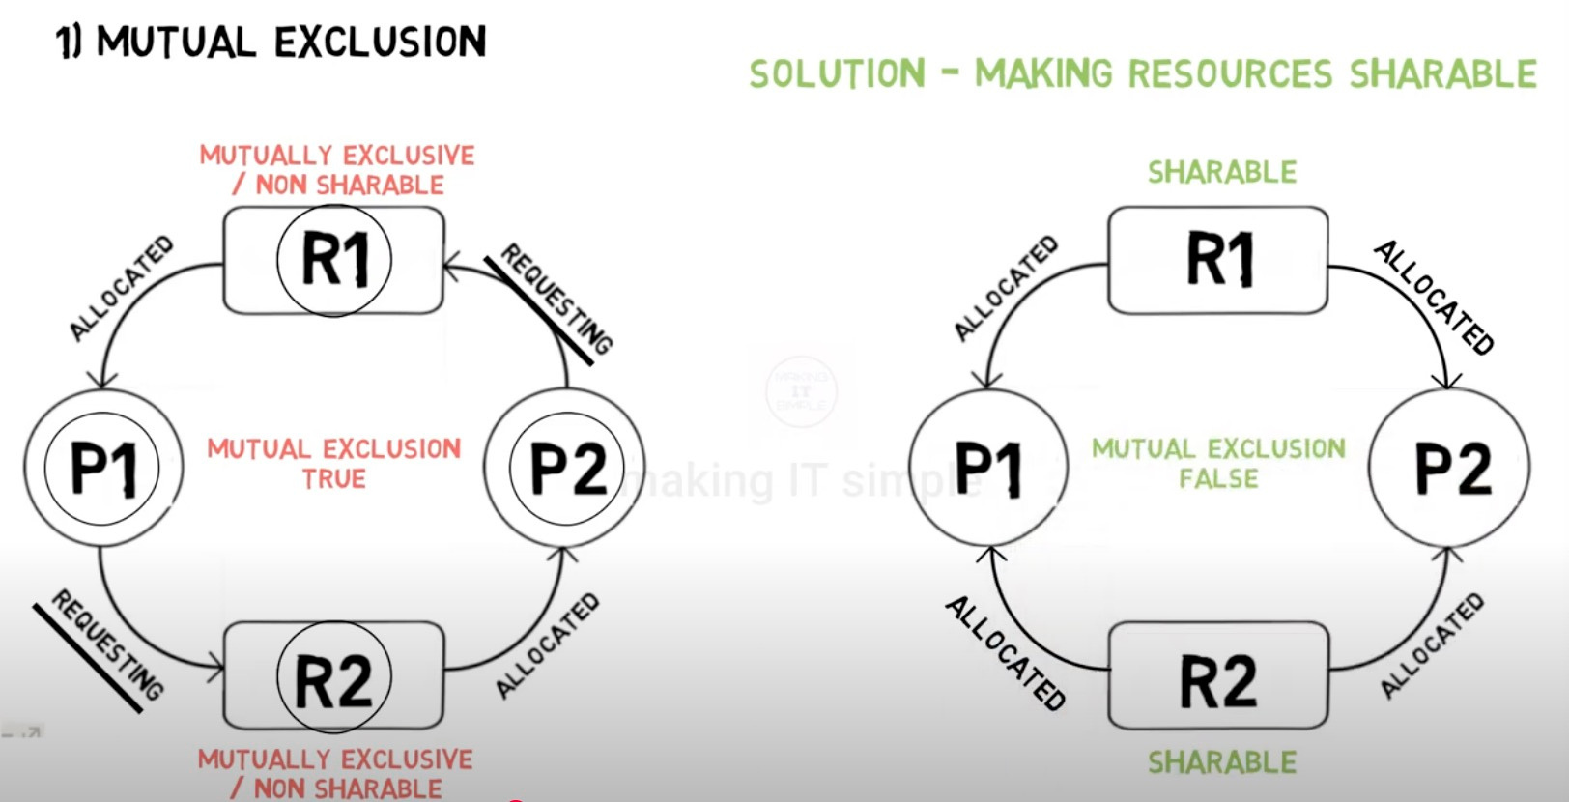

Slide 34




No Preemption
No Preemption
Preemption
Just use time Quantum method

Slide 35
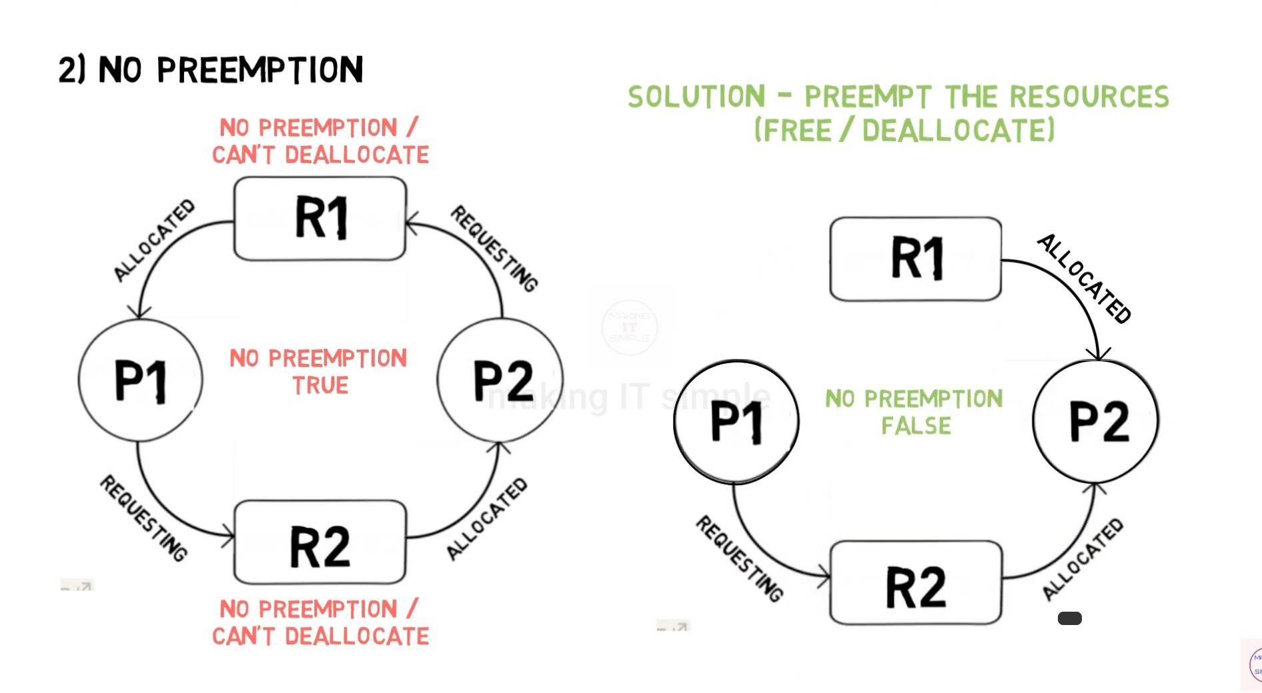

Slide 36




Hold & Wait
Try to no hold and wait Deadlock can be prevented
Give all resources to the process before it start

Slide 37
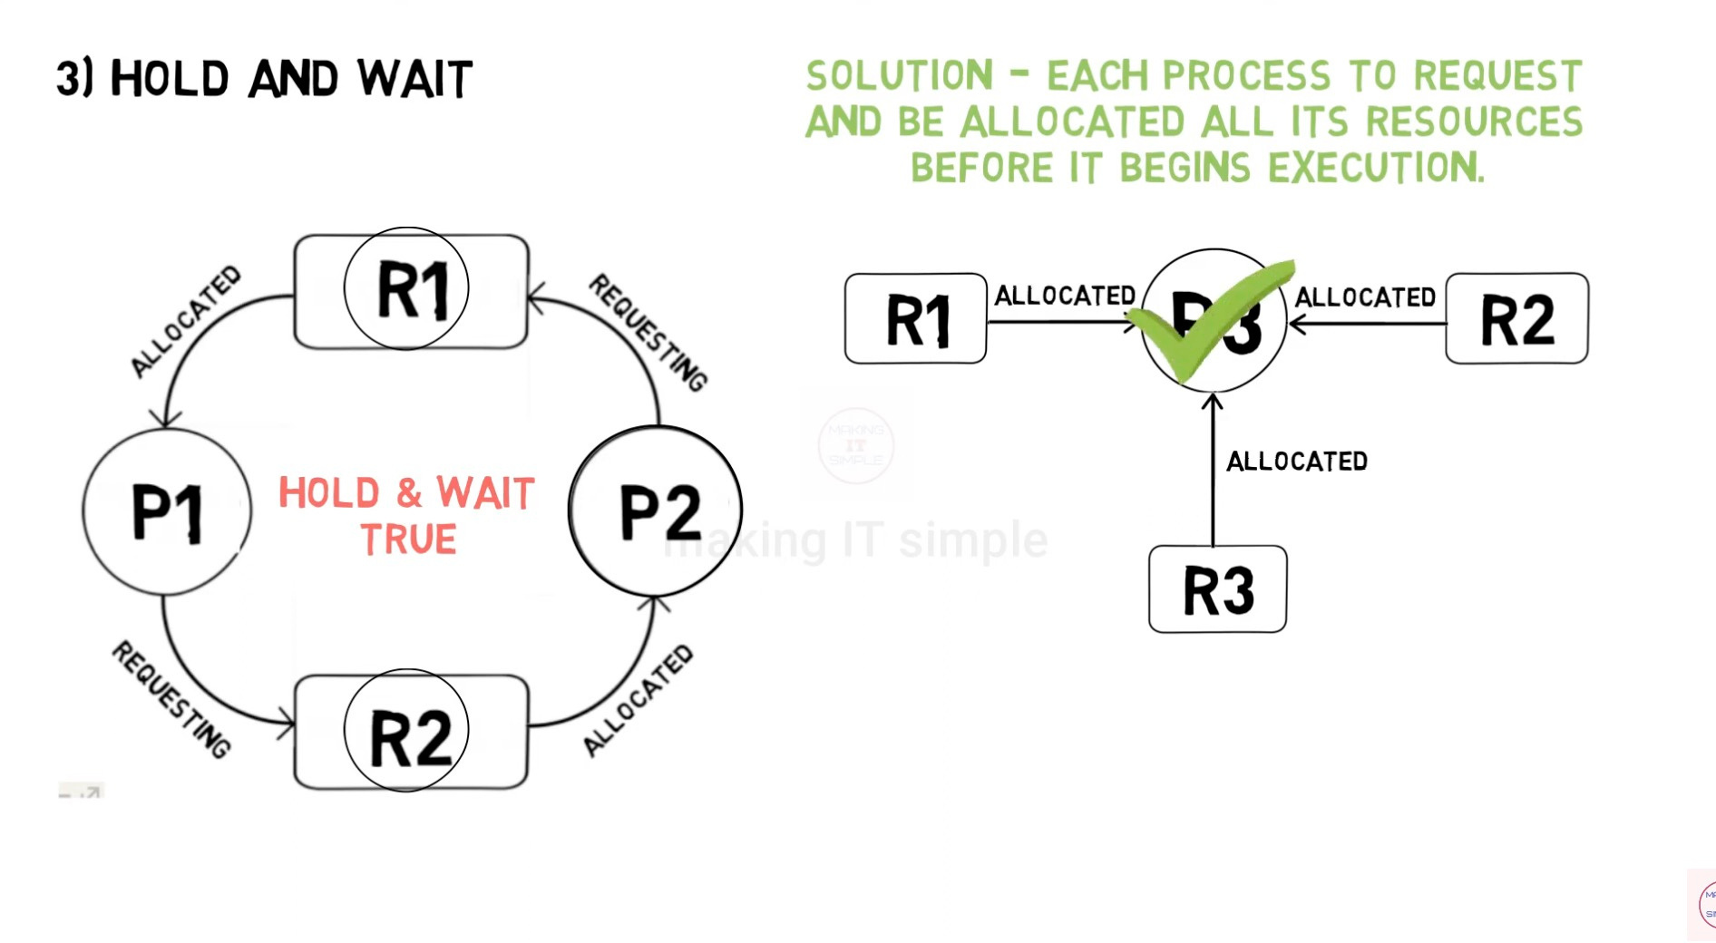

Slide 38


Circular wait
To remove circular wait just give the numbring to all resources

Slide 39
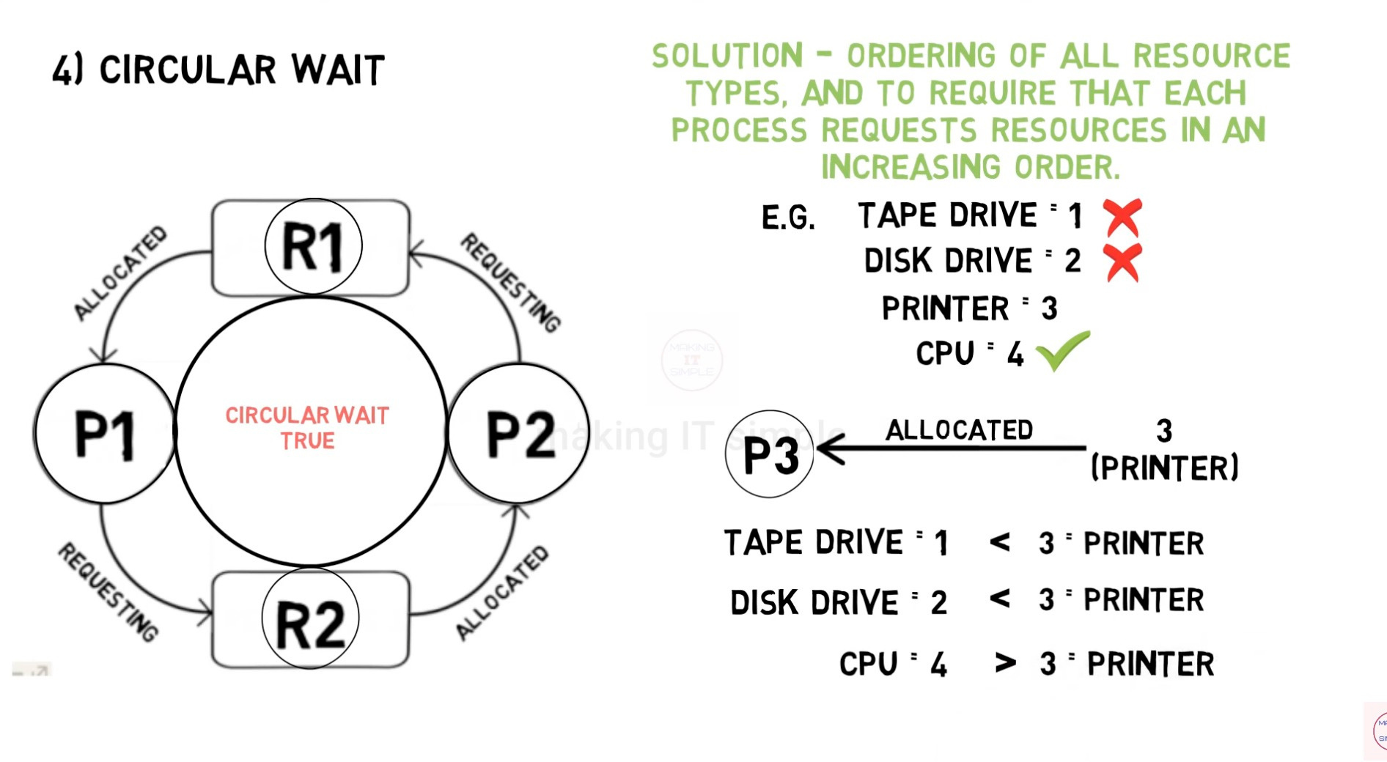

Slide 40
Deadlok Avoidance
Simplest and most useful modest requres that each process declare Max number of resource that it may need
Deadlock Avoidance Algorithm dynamically examines the resource allocation can never be a circular wait condition

Slide 41

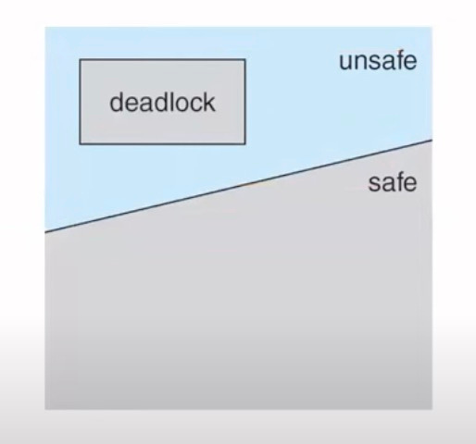


Basic facts:
If a system in safe state > no deadlock
If a system in unsafe state > possibility of deadlock

Slide 42
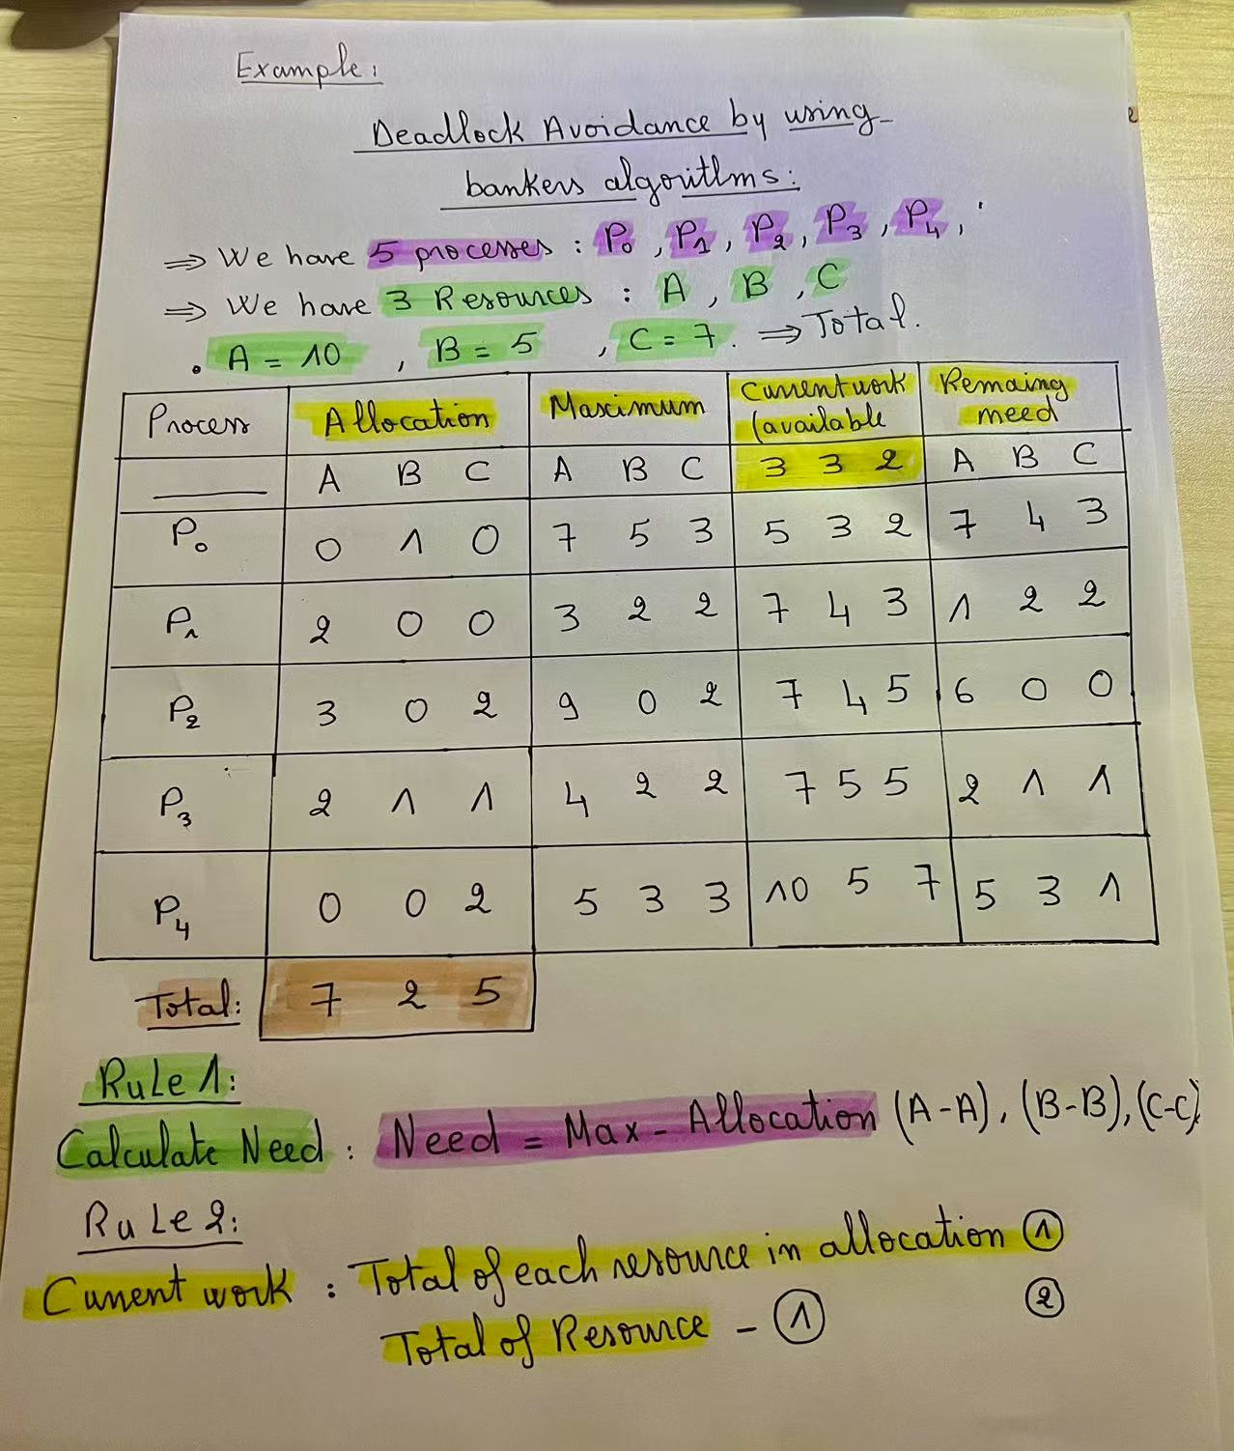

Slide 43

Bankers Algorithm
If Need<= Work
Then Work = current work + allocation
Safe State
Unsafe State
If Need<= Work

Slide 44
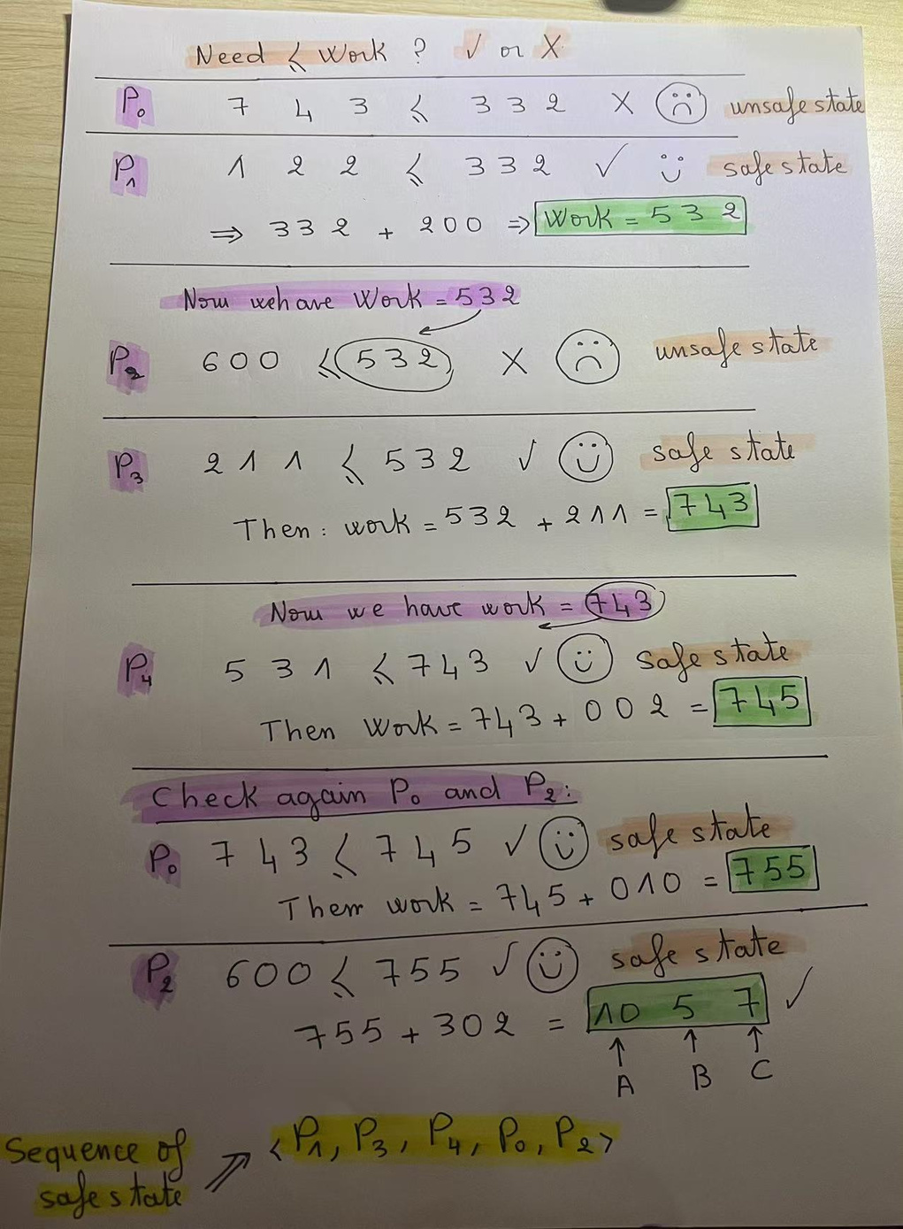

Slide 45



